Slide 1
SMART INDIA HACKATHON
SIH
Worlds’s Largest Open Innovation Platform for Students
Ministry of Education’s Innovation Cell | AICTE

Slide 2




What is Smart India Hackathon?
Smart India Hackathon is a nationwide initiative by the Ministry of Education’s Innovation Cell (MIC) and AICTE. It is recognized as the world’s largest open innovation model that gives students a platform to solve real-world problems faced by government ministries, departments, PSUs, private organizations, and NGOs.
Started in 2017
For Students
Nation Building
Launched to harness student creativity for national problems
UG & PG students from colleges across India
Supports Atmanirbhar Bharat & Viksit Bharat vision

Slide 3
SIH 2025 – Impact Snapshot
271
72,165+
8.2 Lakh+
Problem Statements
Idea Submissions
Students Participated
1,360
60
8th
Teams in Grand Finale
Nodal Centres
Edition (2025)

Slide 4


Two Editions: Software & Hardware
SOFTWARE EDITION
HARDWARE EDITION
Duration
Usually 36 hours non-stop coding marathon
Focus
Web apps, mobile apps, AI/ML solutions, dashboards, digital products
Skills Needed
Programming, UI/UX, databases, cloud, AI
Duration
Multi-day (typically 4–5 days) for prototyping
Focus
Physical products, IoT devices, robotics, sensors, embedded systems
Skills Needed
Electronics, mechanical, embedded, multi-disciplinary teams

Slide 5




Benefits & Rewards
Winning Prize: ₹1,50,000 per problem statement
Plus certificates, internships, mentorship, industry exposure & possible startup support
Skill Boost
Networking
Recognition
Career Edge
Hands-on experience with real problems
Meet mentors, industry experts & peers
National-level visibility & certificates
Internships, jobs & startup opportunities

Slide 6
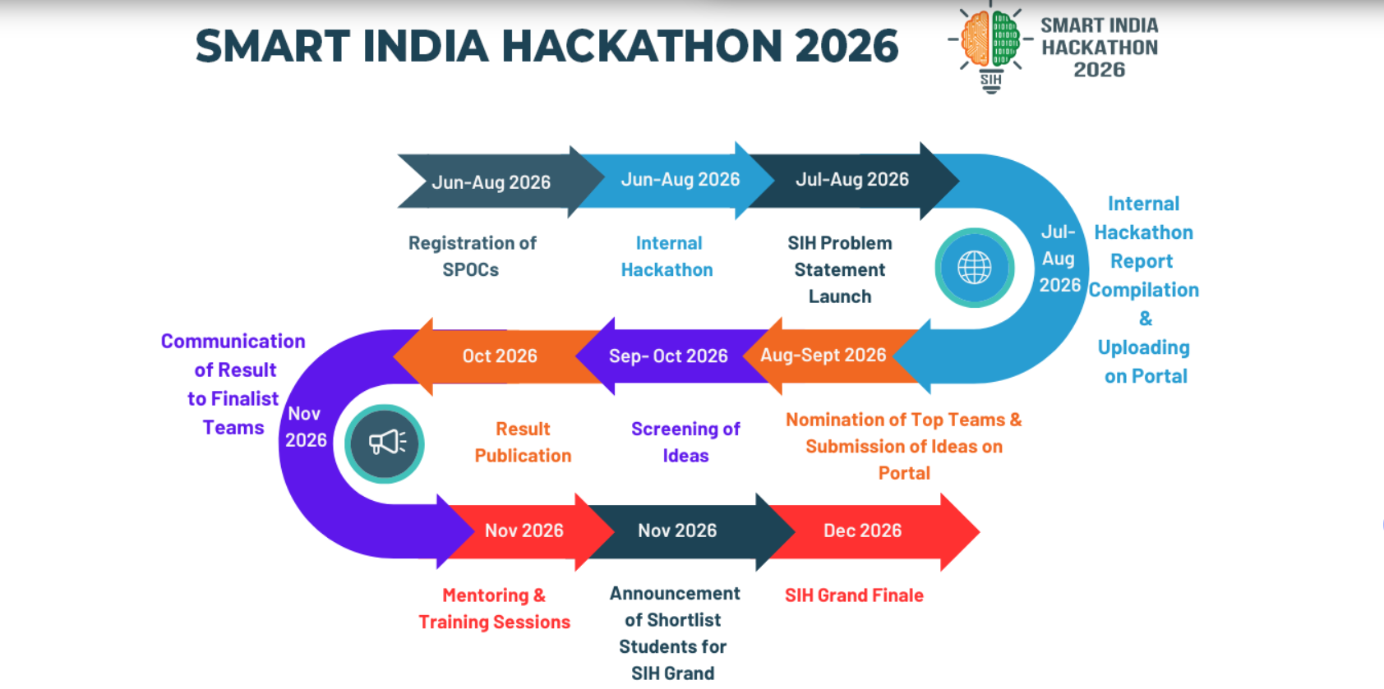

Slide 7
How SIH Works – Step by Step
1
Problem Statements
Ministries, PSUs & companies release real problems on sih.gov.in
2
Team Formation
6 members (min 1 girl) + mentors from the same college
3
Internal Hackathon
College conducts internal selection; SPOC nominates top teams
4
Idea Submission
Selected teams submit ideas against chosen problem statements
5
Evaluation
Expert panels shortlist teams for the Grand Finale
6
Grand Finale
Teams travel to nodal centres and build solutions under time pressure

Slide 8
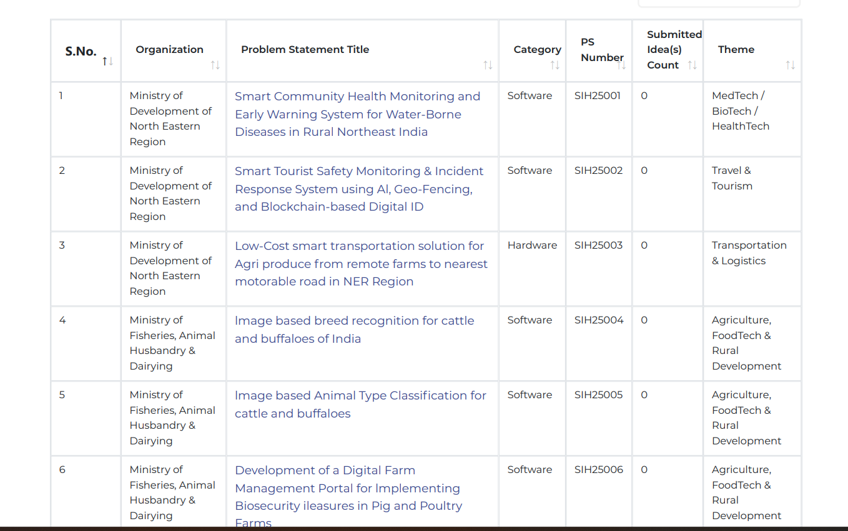
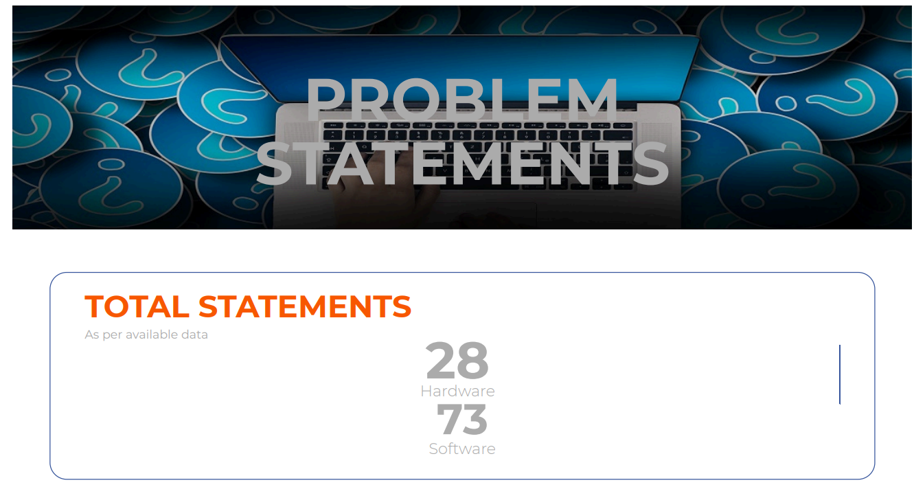
1
Problem Statements
Step 1
https://www.driems.ac.in/wp-content/uploads/2025/09/Smart-India-Hackathon_PROBLEM-STATEMENTS.pdf

Slide 9
Major Themes (Examples)
Renewable / Sustainable Energy
Smart Automation
Agriculture & Rural Development
Healthcare / MedTech
Smart Education
Robotics & Drones
Clean & Green Technology
Cybersecurity & Blockchain
Disaster Management
Space Technology
Smart Vehicles & Logistics
Heritage & Culture

Slide 10

Team Formation
2
Step 2

Slide 11
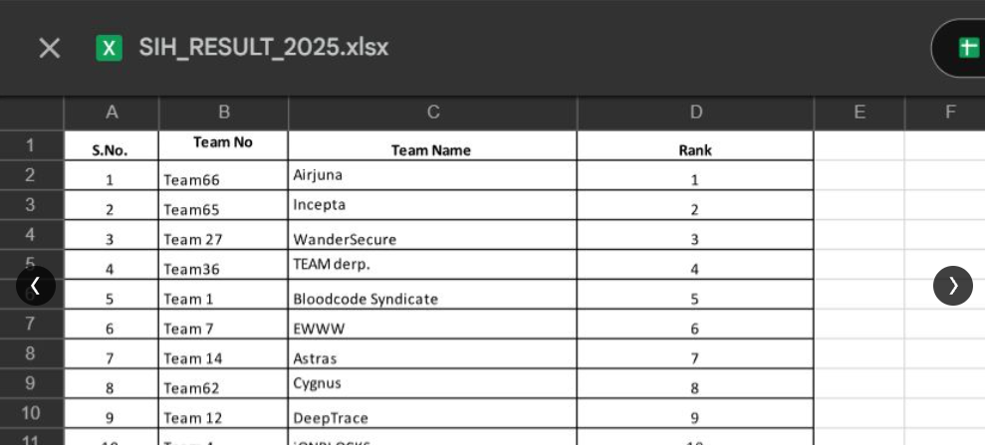
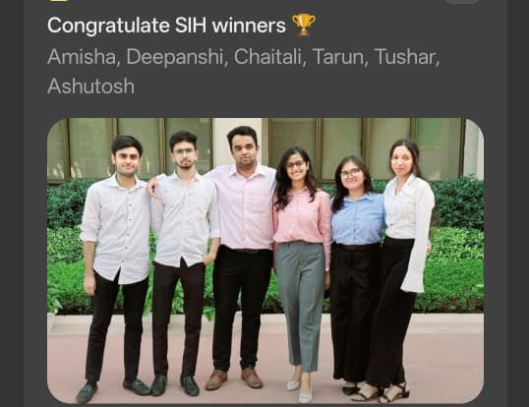
3
Internal Hackathon
Step 3

Slide 12
Idea Submission
4
Step 4

Slide 13
Evaluation
5
Step 5

Slide 14

Grand Finale 2025
SMART INDIA HACKATHON 2025
AIRJUNA
AI-Driven Algae Purifier
Problem Statement ID: SIH25116 | Theme: Renewable / Sustainable Energy
PS Category: Hardware | Team ID: 98513 | Team Name: AIRJUNA

Slide 15



SMART INDIA HACKATHON 2025
TITLE PAGE
Problem Statement ID – SIH25116
Problem Statement Title- Student Innovation
Theme- Renewable/ Sustainable Energy
PS Category- Hardware
Team ID- 98513
Team Name (Registered on portal)- AIRJUNA
Notes:
Hello everyone

Slide 16

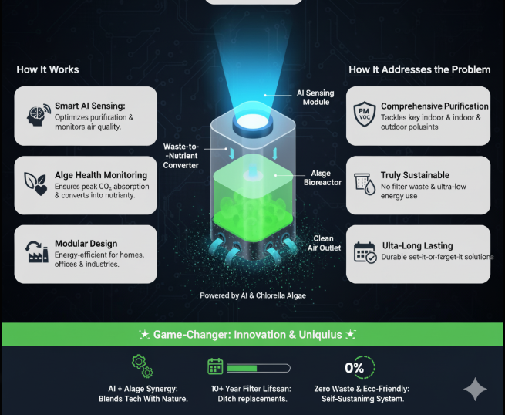
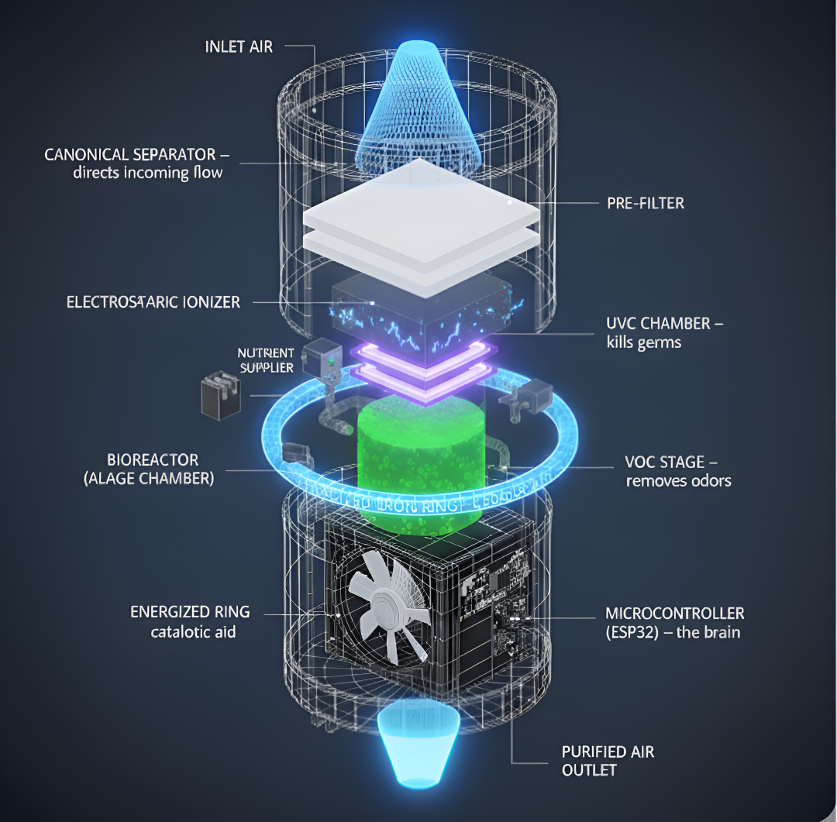
Airjuna: AI-Driven Algae Purifier
Delhi’s severe air pollution exposes people to harmful particulates and gases, while traditional purifiers often fall short. AIRJUNA tackles this with AI controls and living Chlorella algae (organisms that clean air naturally through photosynthesis) delivering a modular, sustainable, and low-maintenance solution for homes, offices, and industries.
DETAILED EXPLANATION
Uses AI-based AQI sensing to optimize purification.
Algae health monitoring ensures peak CO₂ absorption.
Smart waste recycling converts waste(CO2, NO2)into nutrients
algae photosynthesis to stay alive
Energy-efficient, modular design for homes, offices & industries.
HOW IT ADDRESSES THE PROBLEM
Comprehensive: Tackles key indoor and outdoor pollutants (PM, CO2​, VOCs).
Sustainable: No filter waste and lower energy use compared to traditional purifiers.
Long-Lasting: A durable, set-it-and-forget-it solution for clean air.
INNOVATION & UNIQUENESS
AI + Algae synergy → blending technology with nature.
Self-sustaining system (waste → nutrients).Adaptive, scalable, eco-friendly design.
Low-maintenance Filters (Algae filter life span=>upto 5 years) compared to traditional purifiers(which have life span of 2 years approx).
Innovation & Uniqueness
AI + Algae synergy → blending technology with nature.
Self-sustaining system (waste → nutrients).
Adaptive, scalable, eco-friendly design.
Low-maintenance Filters (Algae filter life span=>upto 10 years) compared to traditional purifiers(which have life span of 2 years approx).

Slide 17
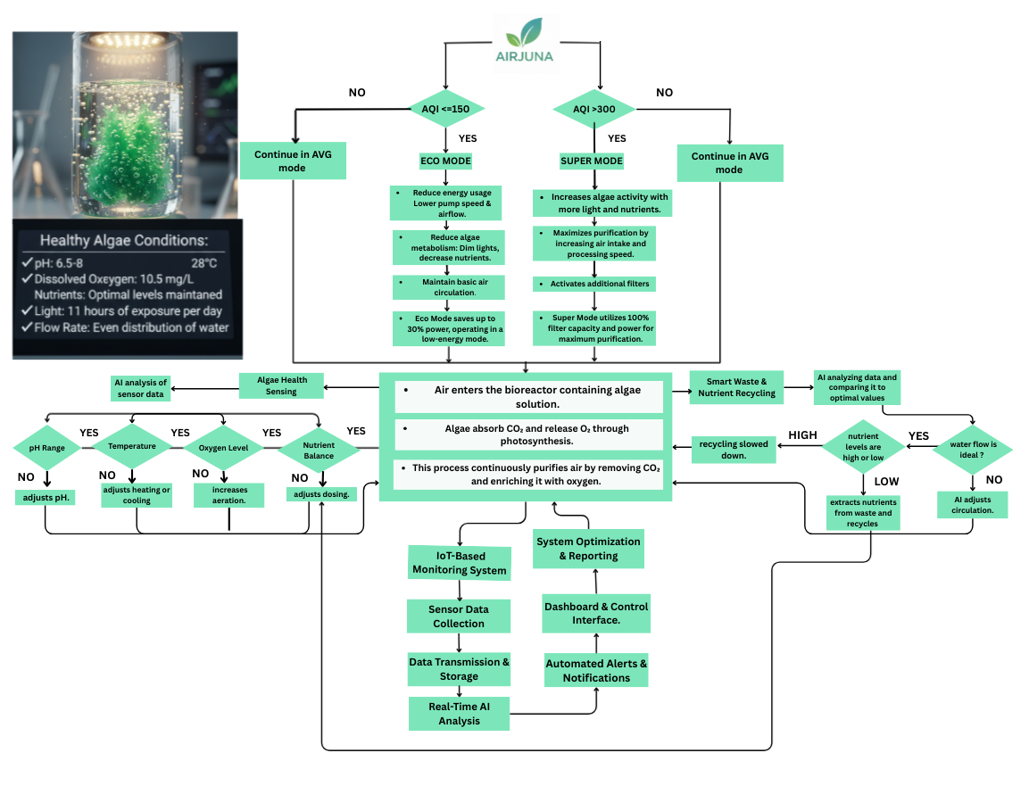

TECHNICAL APPROACH
AIRJUNA
Air Purification:
Multi-stage system using a Canonical Separator, Pre-Filter, Electrostatic Ionizer, Bioreactor (Algae), VOC stage, UVC Chamber (Ultraviolet-C/Germicidal UV), Fan, and Energized Iron Ring. Removes dust, gases, microbes, and absorbs CO₂/NO₂.
Sensors:
PM sensor, VOC (Volality organic sensor) sensor, temperature & humidity sensor, optional CO₂/ΔP sensor. Continuously monitors air quality, pollutants, and environment.
Control Unit:
ESP32 microcontroller with cloud integration. Reads sensor data, adjusts fan and purification stages, and logs operational data.
Support Systems:
Nutrient supplier pump, power supply (PSU), relays/drivers, door interlock, surge protection. Maintains algae health, powers the system (including energy harvesting), and ensures safety and reliability.
FLOWCHART
The Air purifier simulation platform is complete. We can now demonstrate our system's effectiveness, monitor energy use, recommend optimal placement, and compare our performance directly to competitors.
Workflow: Sensors → AI Processing → Control Signals → Purification & Nutrient Regulation → User Dashboard

Slide 18

FEASIBILITY AND VIABILITY
AIRJUNA
Potential Challenges & Risks:
• Maintaining optimal algae growth in varying climates.
•Initial adoption resistance due to unfamiliarity with algae-based systems.
• Sensor calibration and long-term accuracy.
❖Feasibility Analysis:
•Economic: Eliminates expensive filter replacements → up to 60% lower lifetime cost.
•Technical: Uses tested AQI sensor technology & algae research from existing environmental studies.
• Operational: Modular design allows 30% faster deployment than traditional purifiers.
❖Strategies to Overcome:
• Automated nutrient delivery and temperature regulation.
• Awareness campaigns & product demos to boost user trust.
• Periodic AI-driven self-calibration of sensors.

Slide 19




IMPACT AND BENEFITS
AIRJUNA
❖Benefits:
• Cost Savings: No recurring filter costs; low power consumption.
• Eco-Friendly: Climate-positive design; absorbs CO₂ instead of creating waste.
• Health Impact: Removes pollutants, allergens, viruses, and bacteria from indoor air
❖Show Stopper:
India’s first AI-powered, algae-based multi filtered air purifier—blending biological and technological innovation for sustainable, energy-efficient air cleaning and optimal algae health.
❖Impact:
• Potential to reduce indoor CO₂ by up to 35% in 24 hours.
• Improves AQI to healthy levels in under 60 minutes in a standard room
• Reduces e-waste from filter disposal by 100%.
MADE IN INDIA

Slide 20

RESEARCH AND REFERENCES
AIRJUNA
[1] P. G. Falkowski and J. A. Raven, Aquatic Photosynthesis. Princeton, NJ, USA: Princeton Univ. Press, 2013. [Online]. Available: https://www.researchgate.net/publication/41931921_Aquatic_Photosynthesis_Paul_G_Falkowski_John_A_Raven
[2] W. Blanken, M. Cuaresma, R. H. Wijffels, and M. Janssen, "Cultivation of microalgae on artificial light," Biotechnology Advances, vol. 31, no. 3, pp. 164–186, 2013. [Online]. Available: https://www.sciencedirect.com/science/article/abs/pii/S221192641300091X
[3] L. Barsanti and P. Gualtieri, Algae: Anatomy, Biochemistry, and Biotechnology. Boca Raton, FL, USA: CRC Press, 2014. [Online]. Available: https://www.taylorfrancis.com/books/mono/10.1201/b16544/algae-laura-barsanti-paolo-Gualtieri
(Full reference list available in report scan the QR for the full list)

Slide 21
SMART INDIA HACKATHON 2025
AIRJUNA
AI-Driven Algae Purifier
Problem Statement ID: SIH25116 | Theme: Renewable / Sustainable Energy
PS Category: Hardware | Team ID: 98513 | Team Name: AIRJUNA
QUESTIONS?

Slide 22
Ready to Innovate?
Visit the official website
www.sih.gov.in
Talk to your College SPOC and form a team!
No problem is too big… No idea is too small.

